Slide 1
Business letters
SALES letter, order letter, inquiry letter and memo

Slide 2
Basic Structure of Business Letter
Heading/Sender's Address
Date
Inside Address
Subject Line
Salutation
Body
Closing
Signature line

Slide 3
LAYOUT OF BUSINESS LETTER
Suitable and correct layout enhances the overall effectiveness of any letter.
The layout helps to arrange all the elements of a formal letter in an organized manner.
Although the basic parts of a letter have remained the same for centuries, the layouts have changed to quite an extent.
Sometimes an organization adopts a certain format as its policy; sometimes the individual letter writer is allowed to choose the format most appropriate for a given letter or to settle on a personal preference. In general, two major letter layouts are widely used.

Slide 4
Block layout
The block layout, also known as the complete block layout is extremely popular as it makes the letter look attractive, elegant, and efficient.
The main characteristic of this layout is that all elements except the letterhead heading are aligned to the left margin

Slide 5
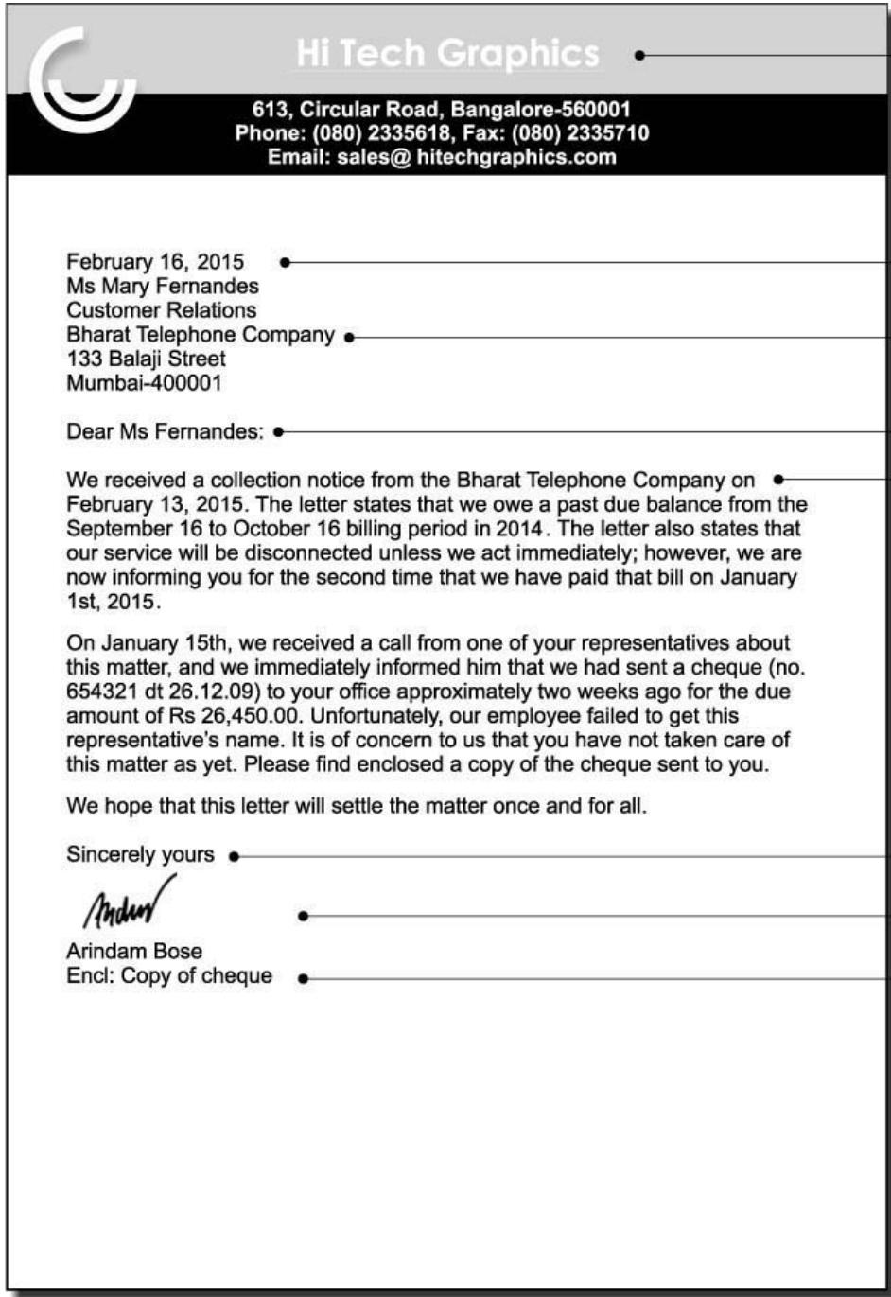

Slide 6
Modified Block layout
The modified block format differs from the block format in the positioning of certain elements:
The heading is center aligned whereas the dateline, complimentary close, and signature block are right-aligned.
Although organizations seem to prefer the full block format, the modified block is also acceptable. The modified block’s appearance is often considered to be more balanced and traditional.

Slide 7
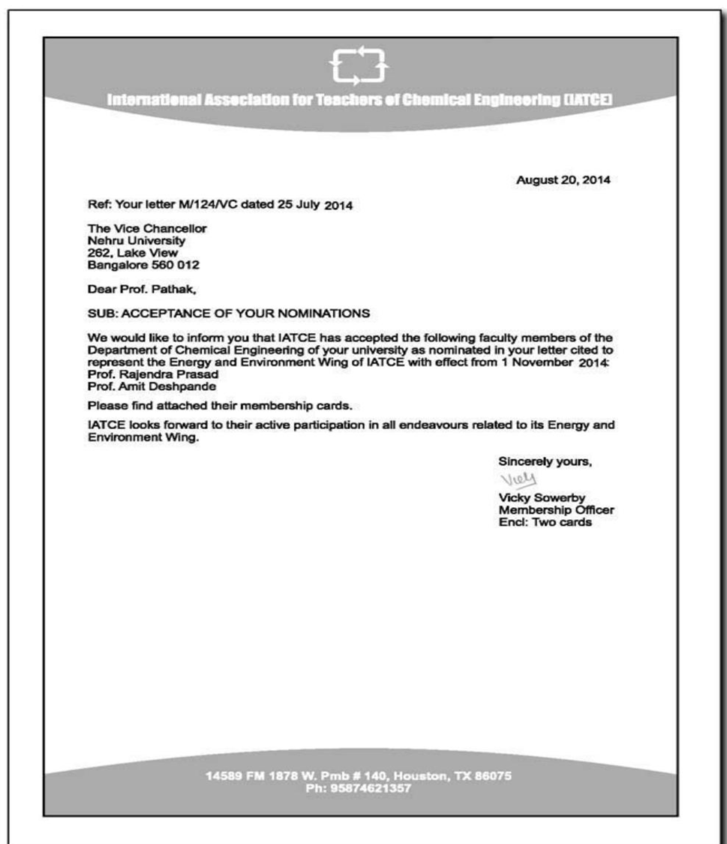

Slide 8
Sales Letter
These letters are meant to present a new product or service to the company’s client or customer.
Sales personnel use these letters to contact prospective buyers and also to strengthen their terms with long-term clients.

Slide 9
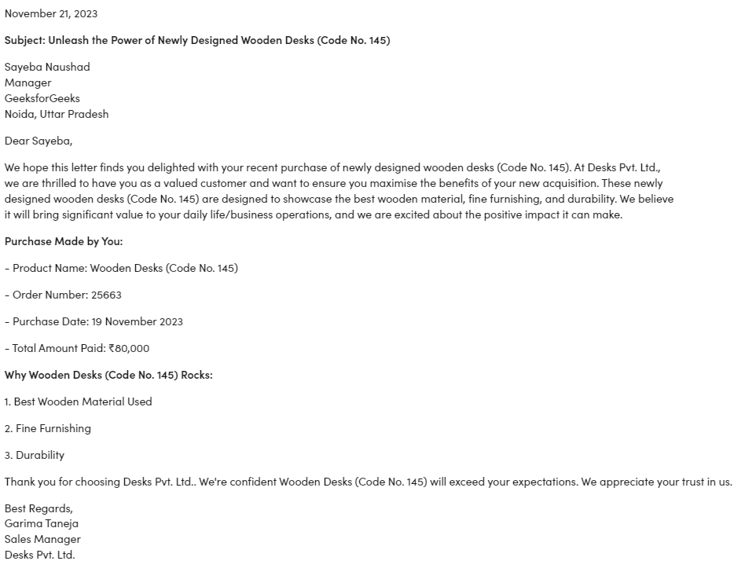

Slide 10
Inquiry Letter
Generally, a client or customer writes this letter and sends it to the organization to ask for details or seek clarifications about the goods.
This will include their quality, quantity, rates, size, delivery charges, discount rates, packing, time of delivery and other terms and conditions.

Slide 11
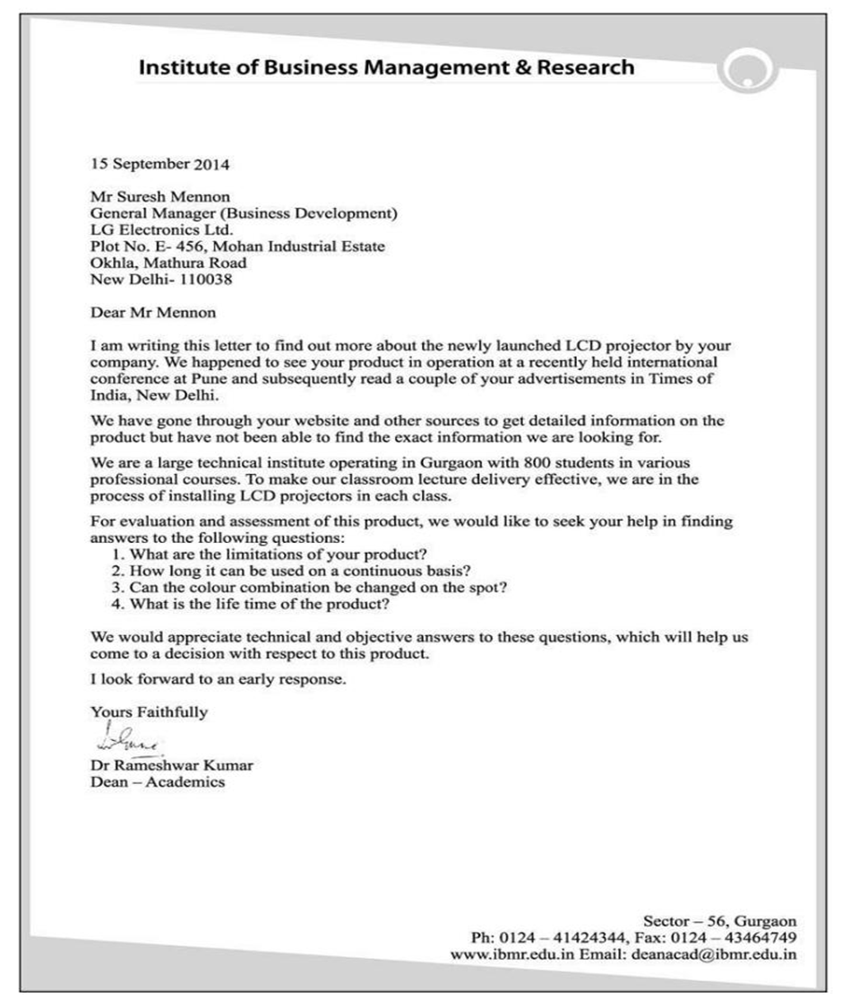

Slide 12
Order letter
As the name suggests, businesses use order letters to place orders for products or services from a vendor or supplier.
So, the motive for writing this letter is buying of materials

Slide 13
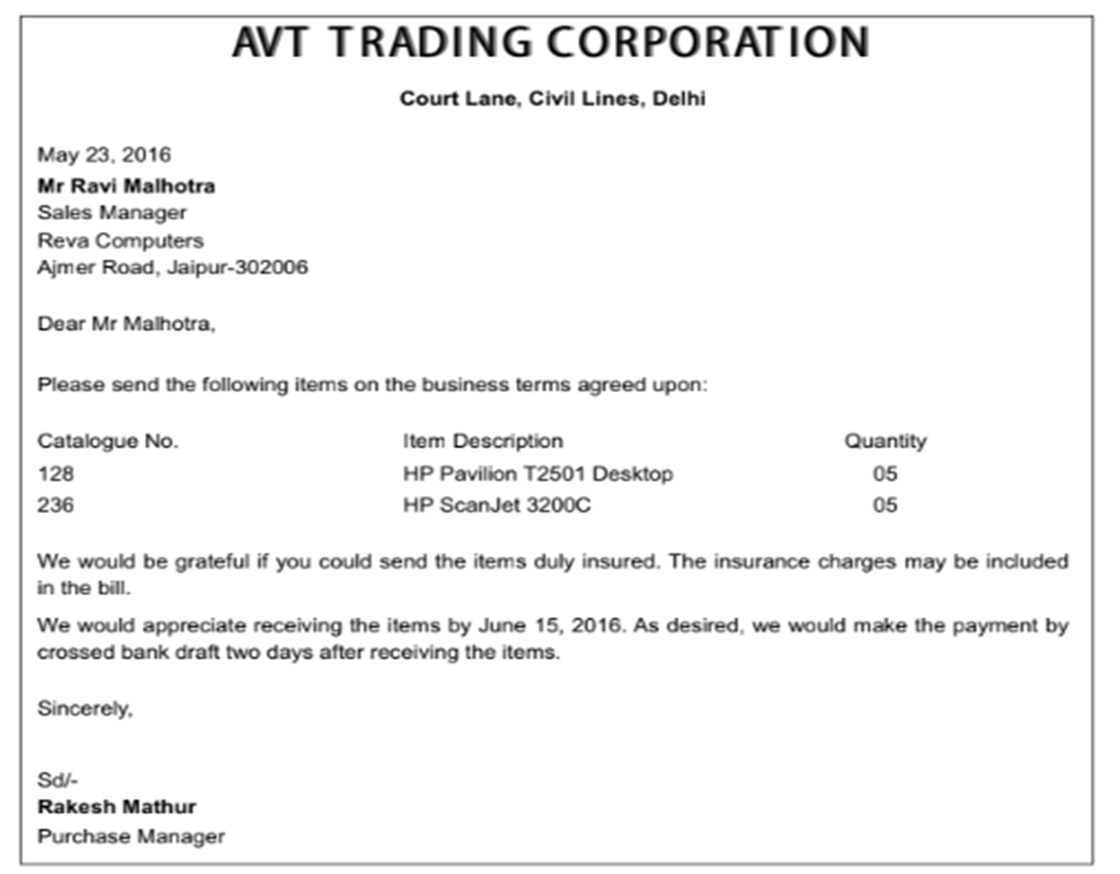

Slide 14
Memo
There are many types and tools for official communication each suited to specific situations. One such popular form of communication is a memo.
A memo is actually short for Memorandum.
It is one of the most used means of official communication in the business world. Its main purpose is to serve as a reminder or to give some instructions.
Again these like circulars are a means of mass communication, i.e. to communicate with a large number of people within the organization.

Slide 15
Continue…
A business memo is a formal written message, written in a conversational form for someone within the organisation to meet a specific need.
It is a form of dialogue, where the writer wants to say something and expects a response to the message.
It is an important means of internal communication used to send information inside an organisation.

Slide 16
Letters Versus Memos
Unlike letters, which are used as a means to reach out to people outside an organisation, memos are used to send information inside an organisation.
A memo is written in a specific format, which is different from the letter format.
Memos are less formal than letters.
Memos are less structured than letters.
The tone of memo is more conversational than that of a letter.
Memos contain less background explanation and information than letters.

Slide 17
The Format of a Memo
Heading: After the name and address of the company (which is on the letterhead) we type the word “Memo’ or ‘Memorandum’ at the top of the page in the center.
Recipient: Address the recipients in the correct format, Example -‘ To: All Employees of the Sale Division’
Writer: Write the name of the person writing the memo, Example – ‘From: Mr. ABC, Head of Sales’
Additional Recipients: These are the people who will receive a courtesy copy of the memo. We don’t address the memos to them, but we keep them in the loop.

Slide 18
Continue..
Date: The date of writing the memos is an important detail that one must include.
Subject Line: This will give the reader a brief idea about the information in the memos. The line must be brief, precise and to the point. Example – Subject: Meeting of all employees of the Sale Division.
The body of a memo: This is where all the information is contained. A formal salutation is not required in a memo. Just relay the necessary information with clarity and precision. The body must not be too long. The ending must restate the issue and end on a positive note.

Slide 19
MEMORANDUM
To: All Employees of the Accounting Department
From: Mr. XYZ, Head of Accounts
CC: Ms. ABC, HR Department
Date: 25 October 2018
Subject: Compulsory Training about the New Software
As you are all aware, we have recently adopted new accounting software at the company. The decision was taken to improve our accounting procedure and make it more time and cost efficient. A training seminar will be held on 5th November 2018 at 9 am to familiarize the staff with the new software. This is done to make the transition between the software as easy as possible. All employees of the department are required to attend.

Slide 20
Thank You!

